Slide 1
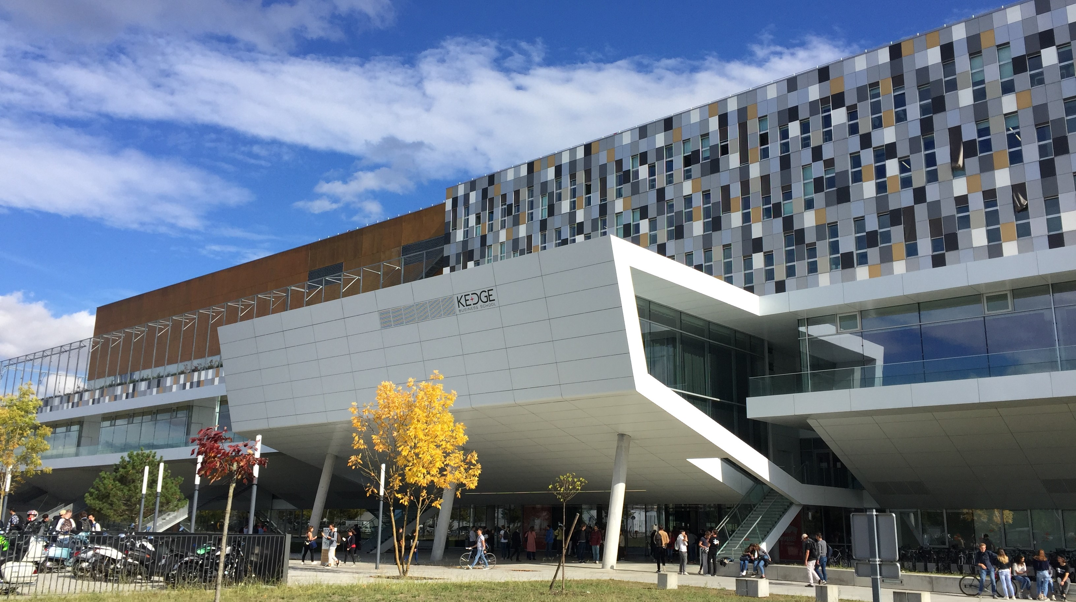


MSc Maritime International Trade & Logistics

Slide 2

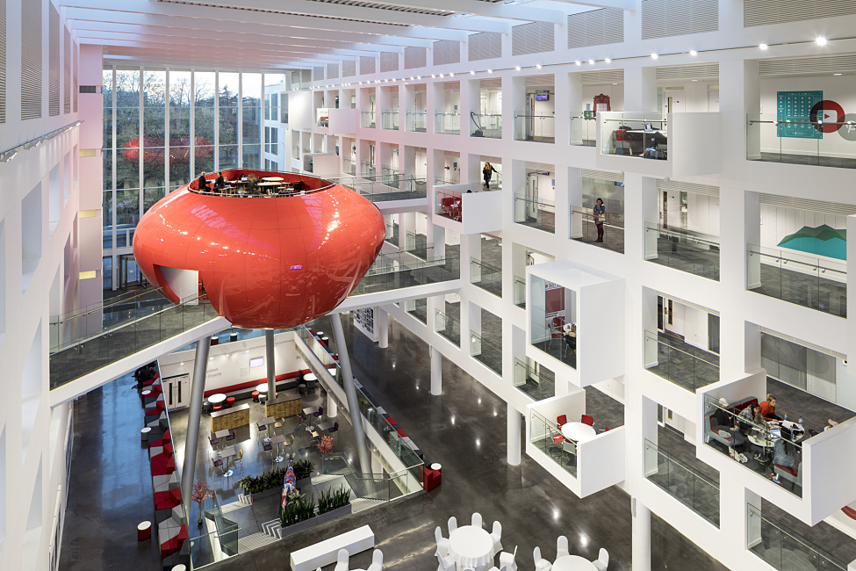
Introduction:-
The Master of Science (MSc) in International Trade and Logistics approach to training emphasises experiential learning and case studies. Students attend industrial conferences and conduct field visits to develop an operational and practical vision
The triple-sectoral approach -international trade, logistics, international transport- is in line with the current needs of the companies and challenges of our global world.

Slide 3

Facts & Figures:-
Duration:- 15 Months or 24 Months
Fees:- 16500 Euros / 25000 Euros
Start date:- September Every Year
Mode of conduct:- Lectures/ classroom
Batch size:- 20
Number of nationalities:- 12
Ranking:- KEDGE Business School ranks 9th in the 2022 Le Figaro ranking.

Slide 4
Core modules
Long Track 24 Months
SEMESTER 1
Upgrade in international trade and finance
International risk management
International strategy
International transport
International carriage law
Logistics, fundamentals concepts
Taxation & Customs operations
Presentation of a project in front of a professional panel
SEMESTER 2
Port competition and strategy management
International negotiation
Law of international contracts
Geopolitics and international finance
Multimodal transport management
Logistics, flows and inventory management

Slide 5
Core modules
SEMESTER 3
SEMESTER 4
International risk management
International strategy
International transport
International carriage law
Logistics, fundamentals concepts
Taxation & Customs operations
Presentation of a project in front of a professional panel
Port competition and strategy management
International negotiation
Law of international contracts
Geopolitics and international finance
Multimodal transport management
Logistics, flows and inventory management

Slide 6

Accreditations:-
In 2021-2022, the Financial Times has ranked KEDGE 40th best European business school, and 9th best French business school.
The Grande Ecole (MIM) programme ranked 67th among the best masters in management worldwide.
The Executive MBA ranked 38th worldwide on the podium of the world top 100 EMBA and 6th in France.
KEDGE Business School ranks 9th in the 2022 Le Figaro ranking.
KEDGE is ranked 10th once again in 2022 by 'L'Etudiant’.
BEM Dakar (KEDGE in Senegal) tops once again the podium of the best business school in Africa according to the 'Jeune Afrique' magazine in 2021.
Many specialised programmes, Masters of Sciences and Specialised Masters, have achieved good positions in the Eduniversal 2021 ranking. The master's degree ISLI Global Supply Chain Management has ranked at number 3 at Eduniversal best masters in the Supply Chain Category.

Slide 7

Location and Advantage:-
Marseille/France
The campus in Marseille is divided between two sites: the Luminy campus nestled on the edge of the Calanques National Park, and La Joliette campus located in the heart of the city.
State-of-the-art facilities
The creation and modernisation of spaces allows for a better adaptation to new teaching methods and improve the studying experience. The facilities have been redesigned as stimulating workplaces with a strong technological edge.
Over a period of three years, renovation and modernisation work were carried out on more than 21,000m2 of buildings. Thanks to the project, the Luminy campus is positioning itself as one of the leaders in the field of education providing the most innovative facilities and teaching equipment. It offers its scholars exceptional living and working conditions.

Slide 8
Why this Course/Benefits of the course:-
Alumni Network
The KEDGE Business School Alumni Association is an important worldwide network of 70,000 professionals from all sectors of activity (purchasing, logistics, commerce, finance, management, marketing, communication, wine, etc.)
If you wish to recruit new talents, take advantage of the services offered to recruiters by KEDGE Alumni, the network of KEDGE graduates:
Post your job description on our job board
Participate in our recruitment forums
Benefit from exposure on our social media networks
Consult the online directory of graduates
Become a partner of KEDGE Business School
Offer assignments to KEDGE students
Work in collaboration with KEDGE student associations

Slide 9
Placements/Career Prospects:-
INTERNATIONAL TRADE: Export Sales Manager / Back Office Manager / Business Developer / Head of Export Sales Administration / Import/Export Manager / International Purchaser / Sourcing Manager
INTERNATIONAL SUPPLY CHAIN: Head of Transport Operations & International Logistics / Intermodal Manager / Operations Manager / Transit Manager / Supply Chain Coordinator
MARITIME: Shipping Line Manager / Import Manager, Export Manager / Profit Centre Manager / Cargo Flow Manager / Ship Manager / Harbour Director

Slide 10
Placements/Career Prospects:-
COMPANIES
Arcellor Mittal, Airbus, Alinea, Alten, Auchan, Bolloré, Bourbon Management, Business France, Cabesto, Carrefour Supply Chain France, CMA-CGM, DB Shenker, Daher, Danone, Decathlon, DPD France, Esso SAF, Feeder, Gemalto, Geodis Wilson France, Gondrand, Grand Port de Marseille-Fos, Groupe Avril, Kuehne Nagel, Leroy Merlin, Marine Nationale, Pernod Ricard, Pôle Mer Provence-Alpes-Côte d’Azur, SDV Logistique et Carburants Spéciaux, Seafood Export, Syndicat des Transitaires de Marseille, Traxens, Unilever, Union Maritime et Fluviale, Veolia Water STI, XPO Logistics, Zim

Slide 11
Application Requirements:-
Long Track: 3 years of higher education "Bac+3" validated by a diploma or an equivalent of 180 ECTS credits.
Short Track: 4 years of higher education "M1" validated, or an International Bachelor's degree (Bac+4), or an equivalent of 240 ECTS credits.
Level of English required for admission to the specialisation course: TOEIC 780 / IELTS 6 / IBT 85 (candidates with at least 1 year of studies or professional experience in an English-speaking country are exempted). For admission to the preparation course, the level of English is recommended but not mandatory. It will have to be validated to enter the 2nd year.
Connect with us on Education@seaandbeyond.com or +91 89761 24339 for the 2023-2024 Batch

Slide 12
Value Added Services Offered by Sea And Beyond
Education Counselling -
We assist mariners in terms of course & program selection, University Selection and what will be the best possible way to navigate your career.
Visa Assistance -
Immigration to the UK, Australia, Canada and EU. we will help you in getting your student Visa.
Financial Assistance -
We will help you in getting Financial assistance from Banks NBFC With the best interest rates in the market.
Forex Remittance-
We help you in remitting fees to Universities making this process hassle-free.
You can connect with us at education@seaandbeyond.com or +91 89761 24339

Slide 13
Thank You!!!
Connect With Us -
education@seaandbeyond.com
+91 89761 24339

