Slide 1
Shipping & Maritime Business Postgraduate Degree Programmes
MONDAY 13TH June 2022

Slide 2
CONTENTS
01 | Welcome and Introductions from Solent
02 | City of Southampton, Our Solent Campus &
Surroundings
03 | Our Cutting – Edge Facilities
04 | Our Community
05 | Degree Subjects and Warsash Maritime School
06 | Why Students Choose Solent
07 | Hear from Clayton – A current Seafarer
08 | Q & A

Slide 3
Our Focus
Increase YOUR awareness
Provide YOU with consolidated information from credible sources
Help YOU to evaluate relevance of information
Assist YOU to make a well-informed decisions
Some DO’s and DON’Ts please
Please submit questions NOW and with each slide
Our focus today is YOU but please be mindful of others
Slides will be shared later by email
Notes:
Please submit Qs. We will consolidate them before addressing.
Ask Generic Questions please.. Info available on website, google etc..(Which is better, what fees etc..)
Please DO NOT share the slides.

Slide 4
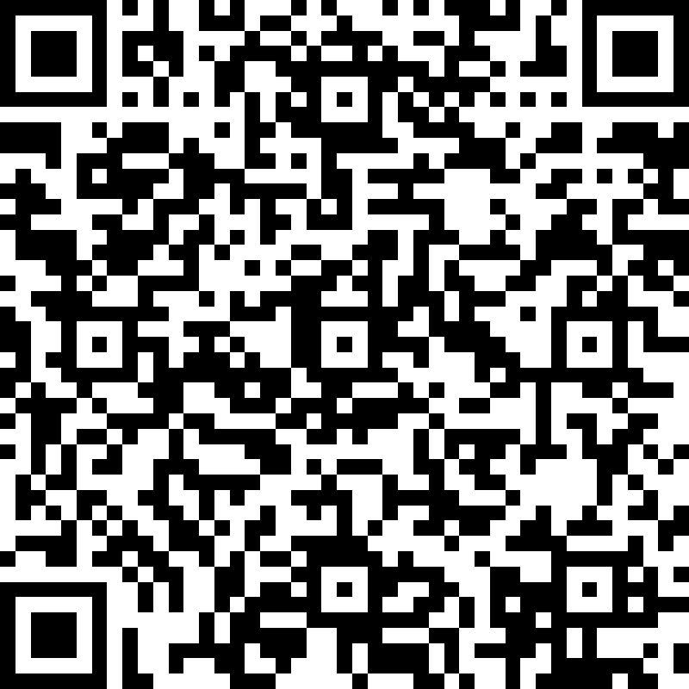
Key Contacts
Meritza Hengari
Senior International Officer (South Asia)
Email: meritza.hengari@solent.ac.uk

Slide 5
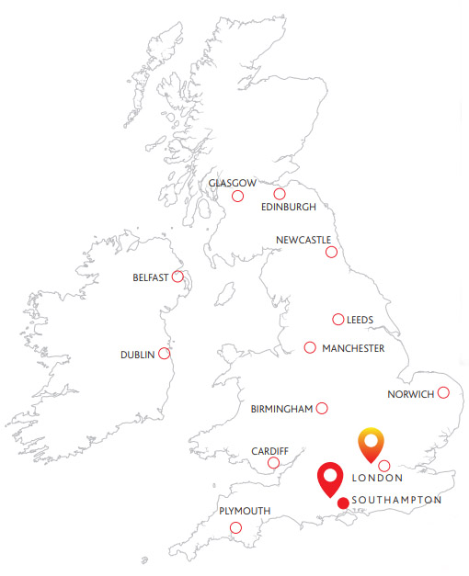
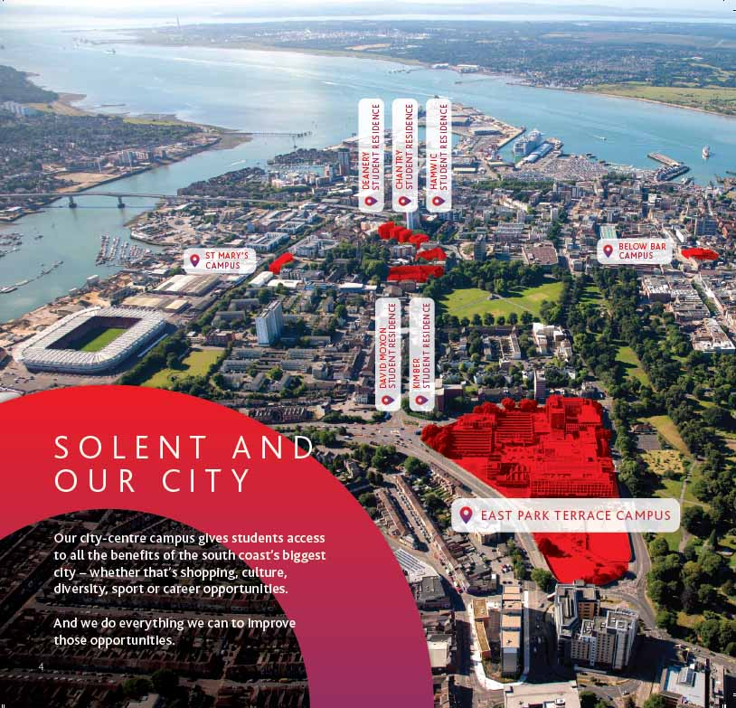
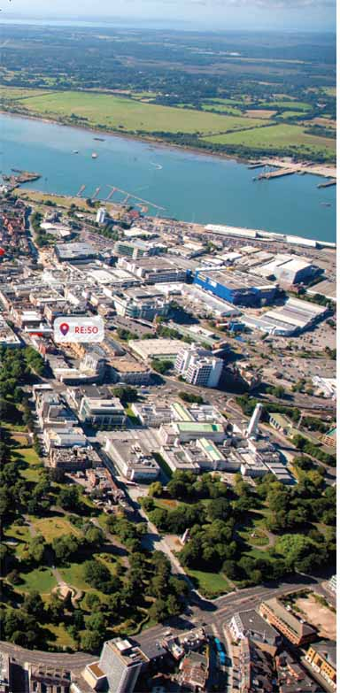
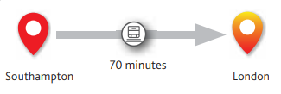
THE CITY OF SOUTHAMPTON

Slide 6
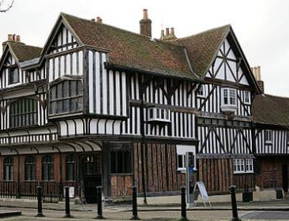
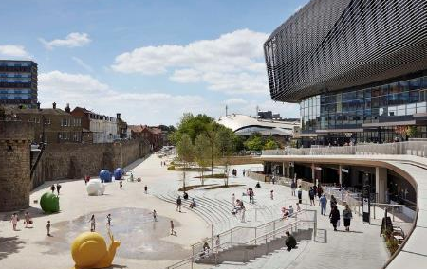
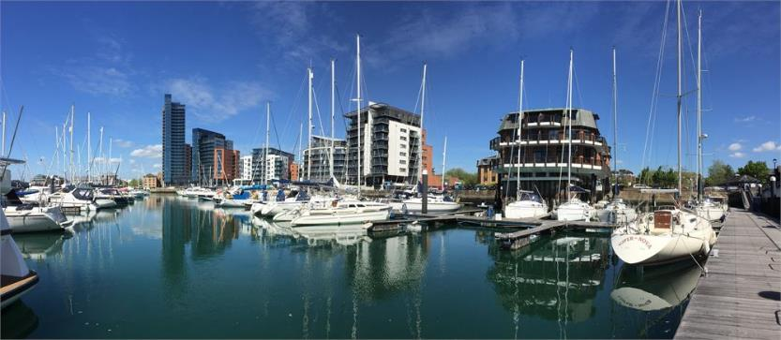
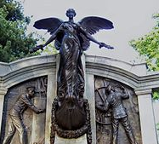
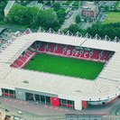
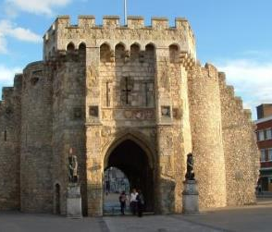
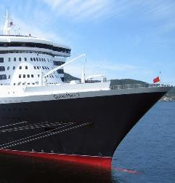
KEY CITY FACTS
The largest city in the south-east outside of London
Population of almost 250,000 people with over 43,000 students
A major port with a rich maritime heritage
Home port of some of the largest cruise ships in the world
£1.6 billion of new city developments committed or underway
180+ cafes, bars, pubs and restaurants

Slide 7
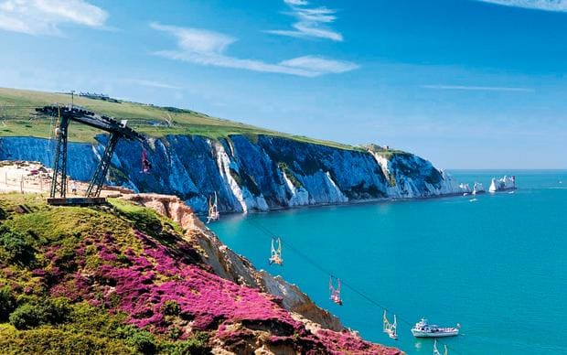
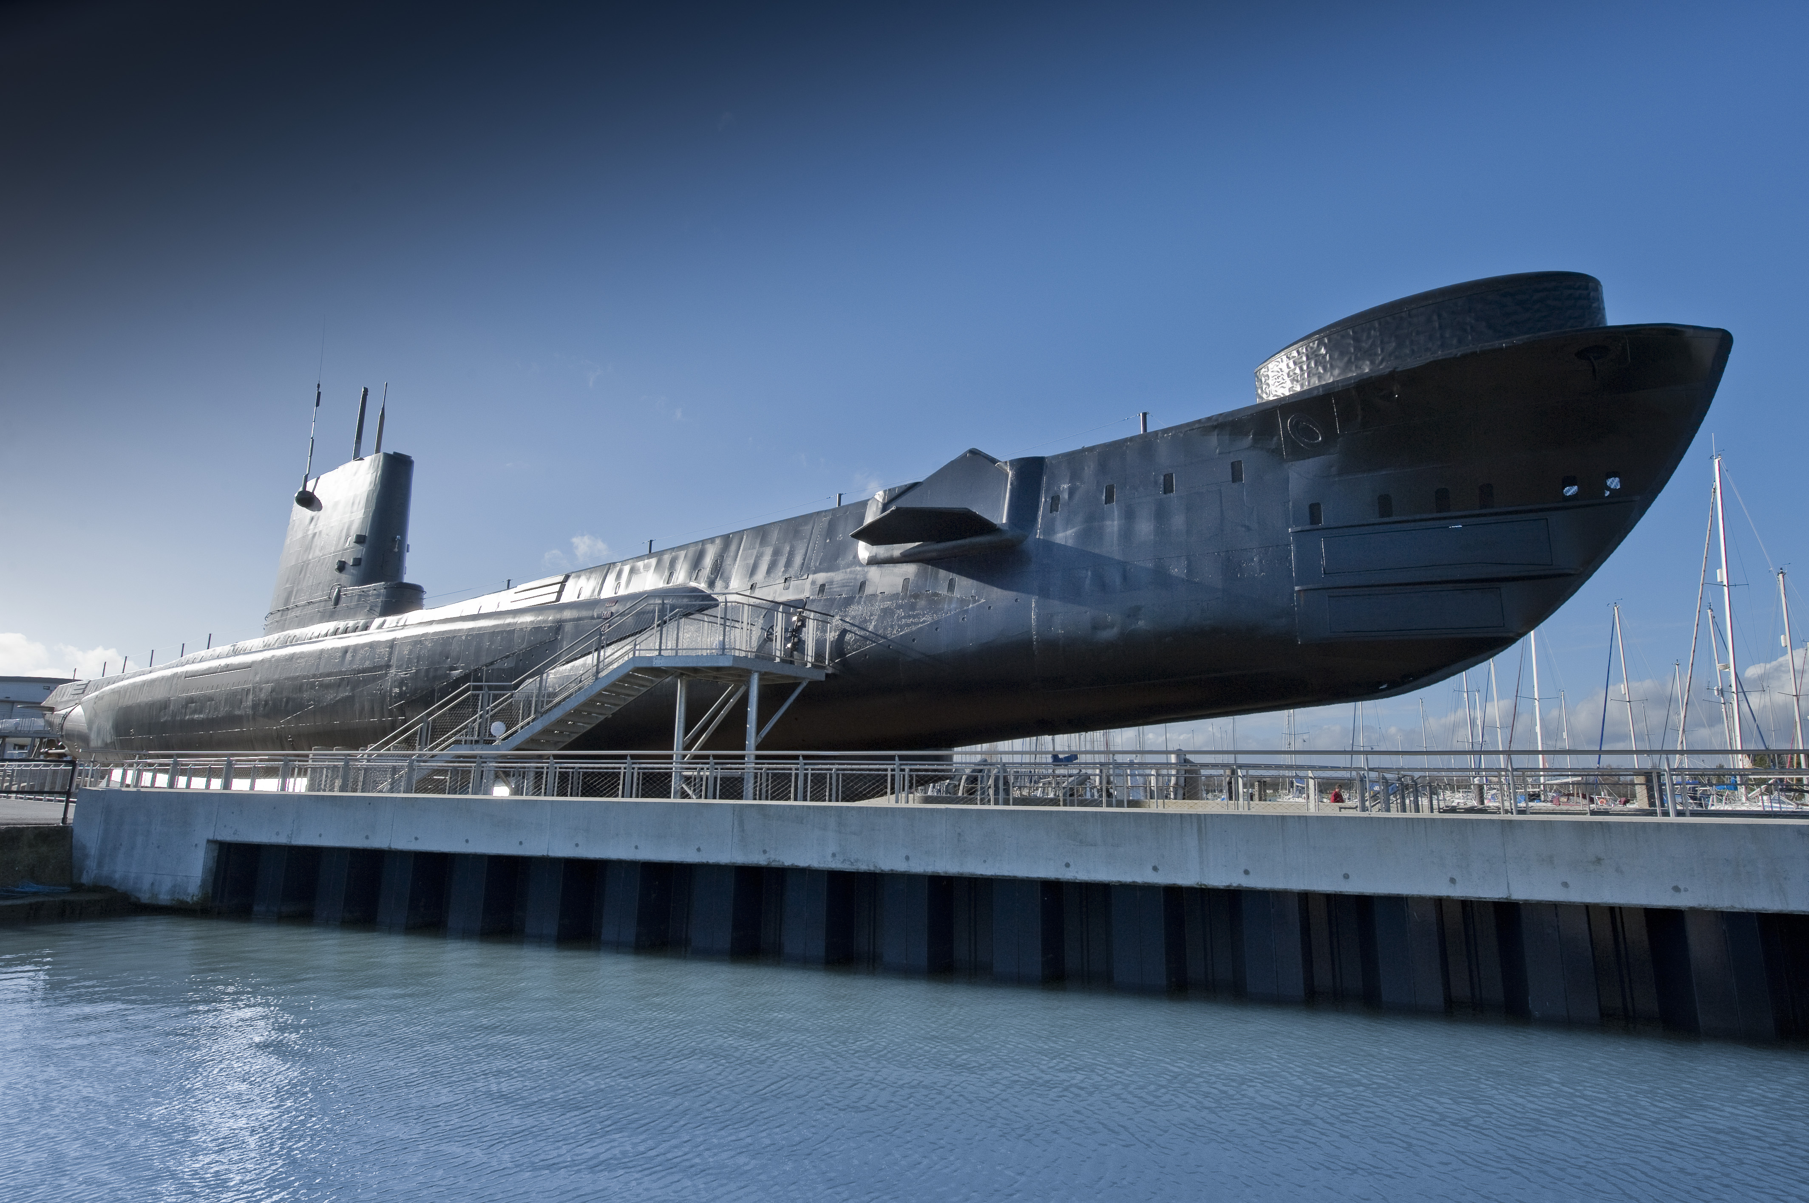
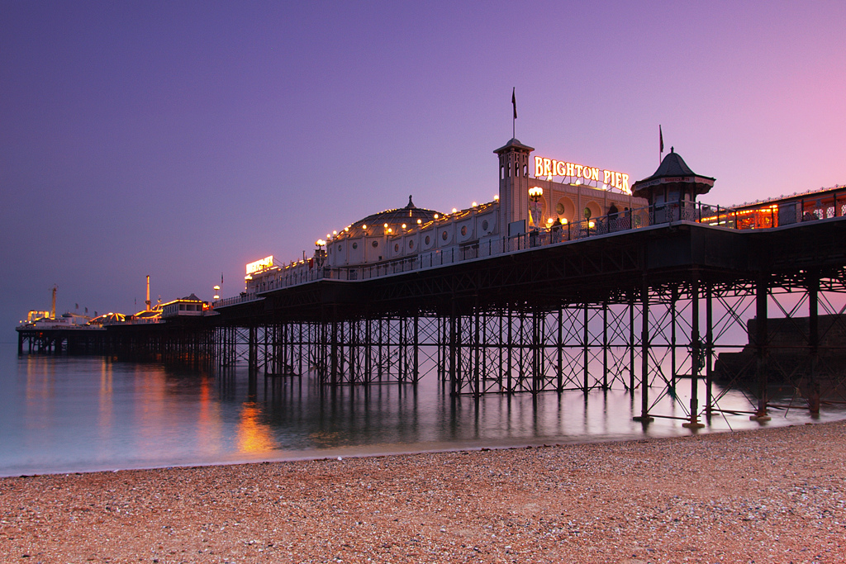
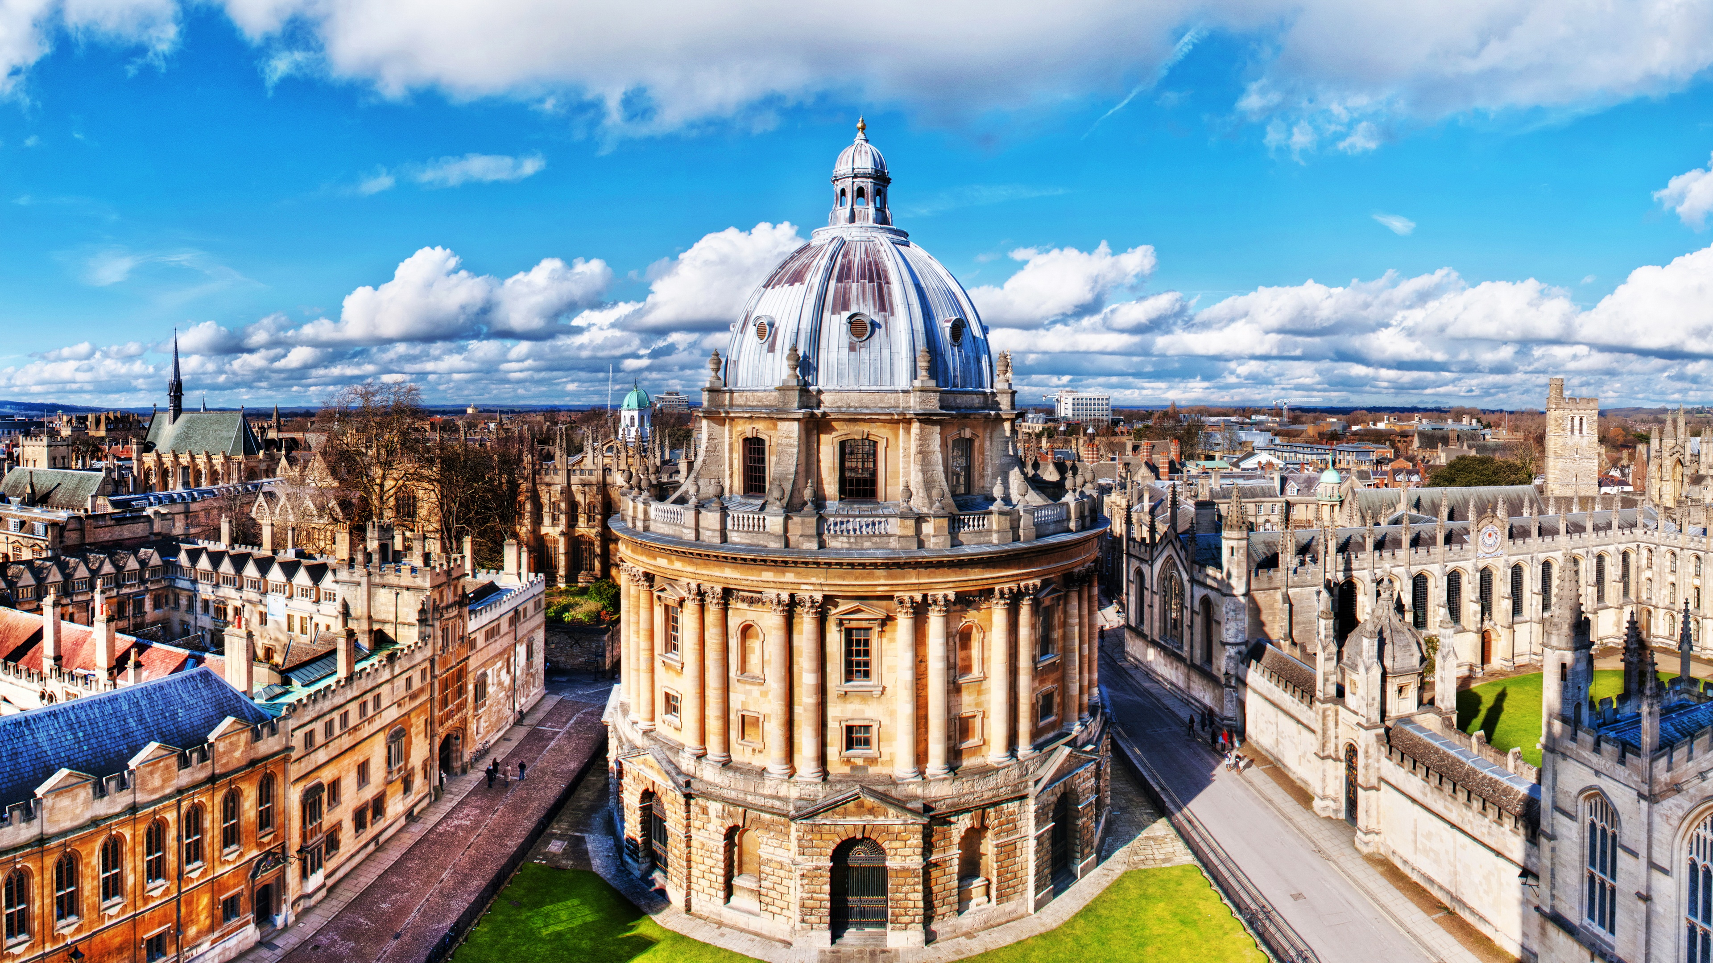
Around Solent- 1 hour drive
East
Portsmouth
West
Stonehenge
South
Isle of Wight
Winchester
North
London
Brighton
New Forrest
Oxford

Slide 8
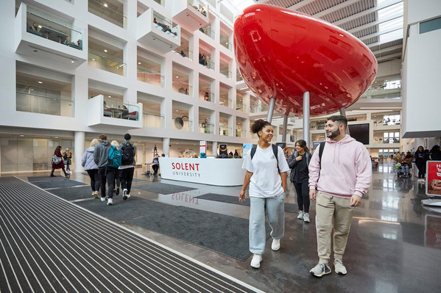
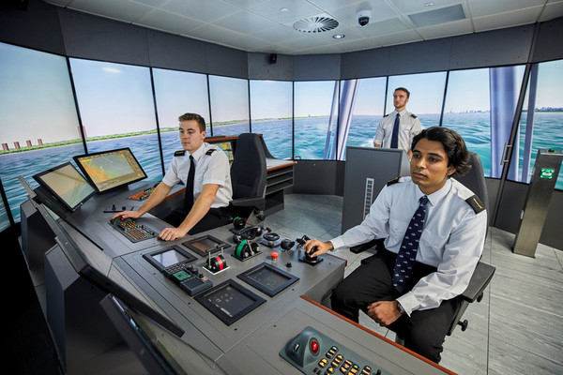
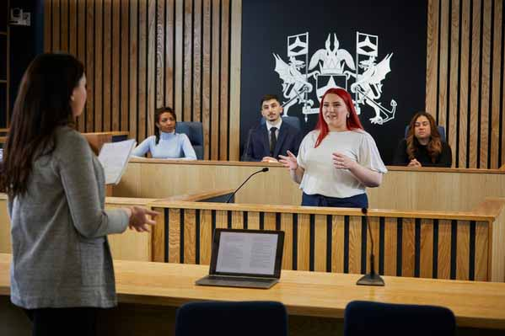
First-class facilities
Award-winning teaching building
UK's largest maritime simulation centre
Specialist photograhy studio
State-of-the-art Sports Complex
Brand new Solent Court room
Adobe Creative Campus
£1 million music recording studios
Nursing, nutrition, biomedical and sport science labs
One of the biggest HD studios in the South of England
Notes:
We are focused on giving you access to the latest professional-grade equipment and facilities.
The Spark: Everything about the building is designed to promote creativity and independent thinking.
Broadcast vehicle: (used by Solent students to broadcast live events such as the Glastonbury FestiVal)

Slide 9
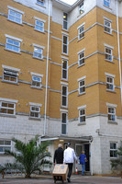
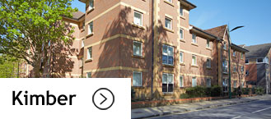
accommodation a place of your own
STUDENT RESIDENCES
En-suite rooms (approx. £5,700)
Non en-suite rooms (approx. £4,900 to £5,000)
Instalments: accommodation fees can be spread across the whole year and paid in either 3 equal instalments - normally October, January and May; or 8 equal monthly instalments.​
​
PRIVATE SECTOR
Private Housing
University Accreditation Scheme SASSH​ (www.sassh.co.uk)
Private Student Residences
Liberty Living, Uni-life, Vita, the Student Housing Company, Collegiate AC and more.
Free access to Solent Sports Complex: gym and classes

Slide 10
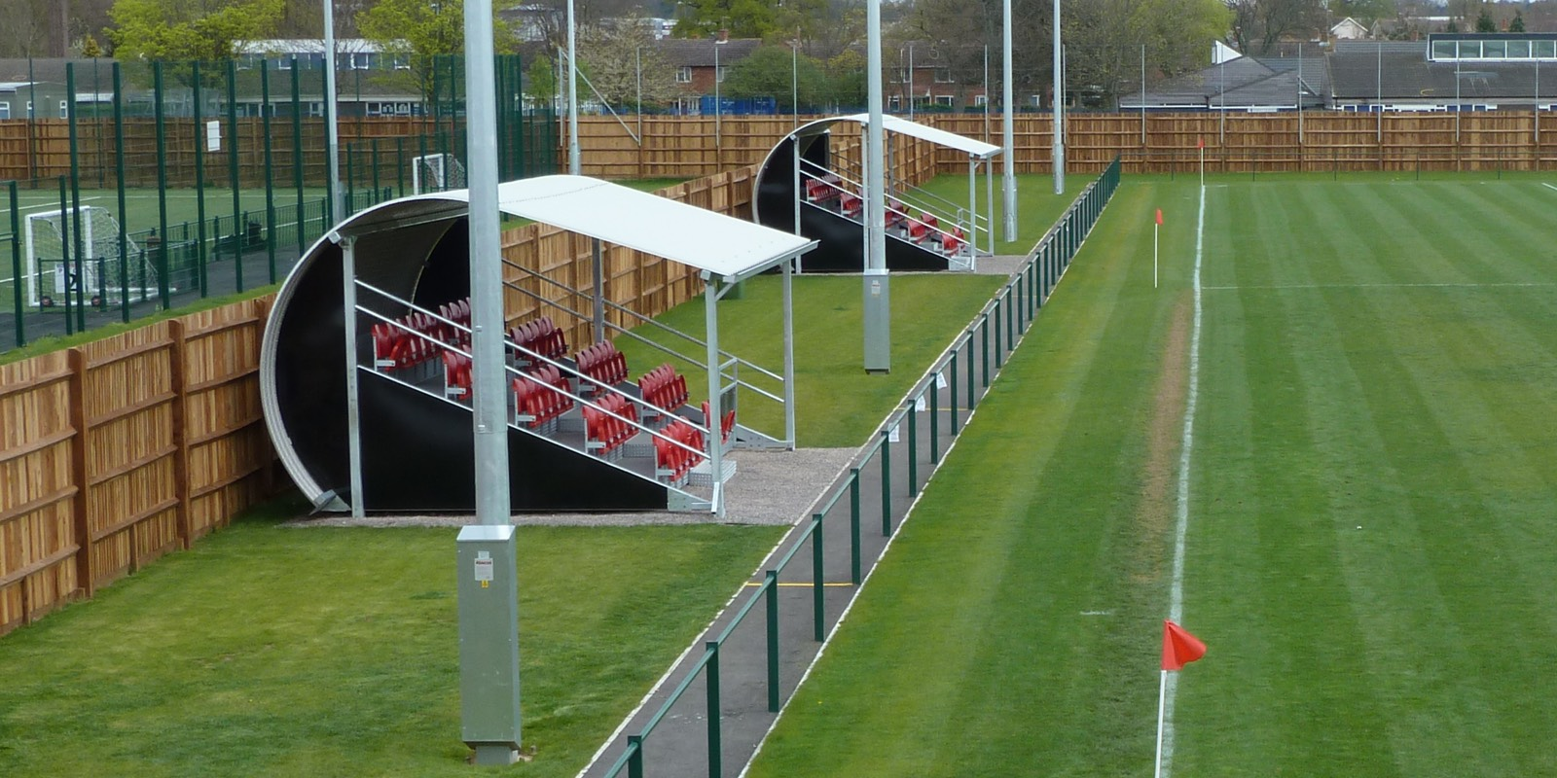
SOLENT SPORT
American football, Table tennis, Sub aqua, Volleyball
Cheerleading and dance, Football, Climbing, Equestrian, Judo, Hockey, Squash, Kickboxing, Windsurfing, Rowing
Netball, Snowsports, Sailing
And more...
Sport Complex (£28m)
Opened in 2019
Test Park Sports Ground
Hosts trainings and matches
Team Solent is the collective name for the 30+ sports teams that compete locally and nationally.

Slide 11
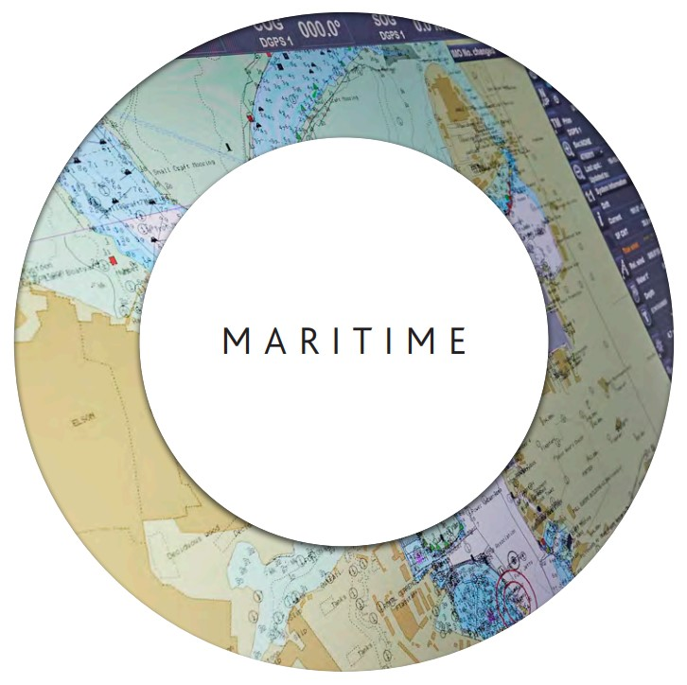
16 degree-subjects

Slide 12
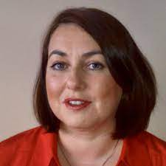
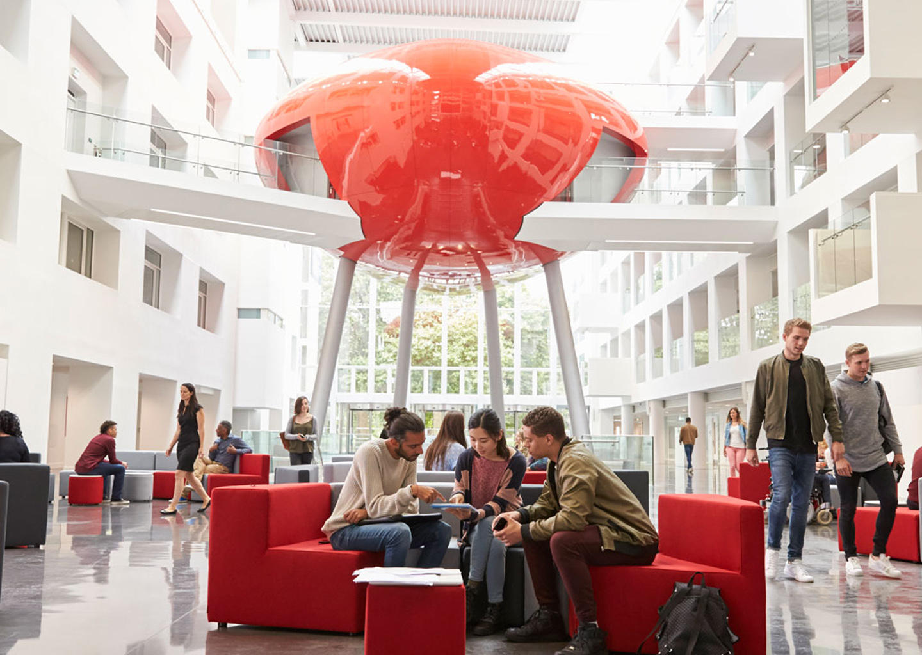
Academic
Nicola Pryce-Roberts
Senior Lecture
Maritime Business and Law

Slide 13
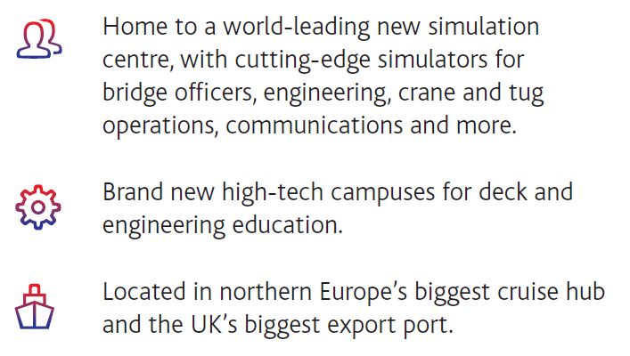
WARSASH MARITIME SCHOOL
Home of seafarer training and maritime studies, building on the history and tradition of the world-renowned Warsash Maritime Academy, with a strong reputation in maritime research.

Slide 14
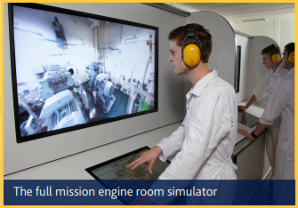
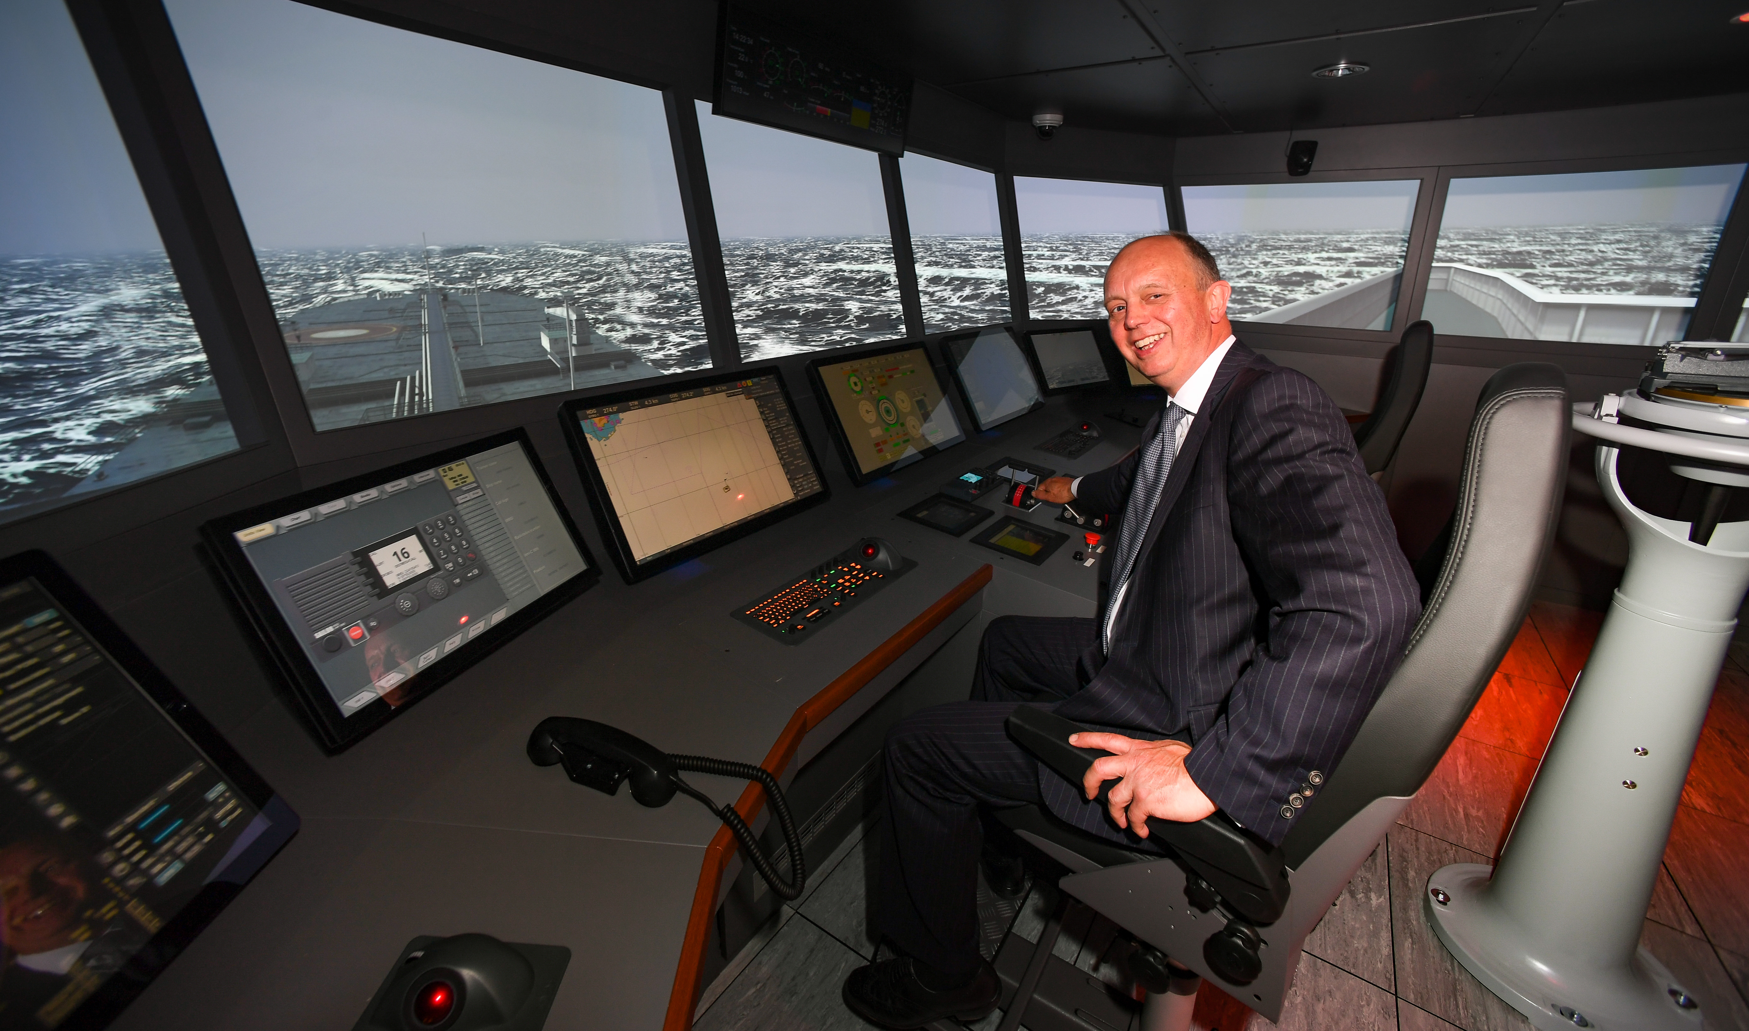
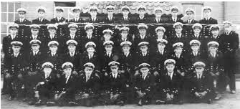
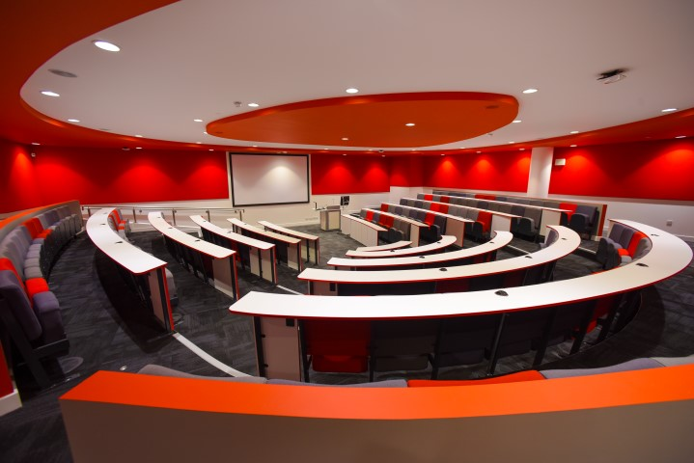
Why study for a maritime degree at Solent UNIVERSITY?
We have a long history and fantastic global reputation as a world class provider of maritime education.
We have deep links with the maritime and logistics industry – our alumni are truly global!
We share our city with Southampton Port, a major UK port and the largest Cruise Terminal in Europe.
We are close to Maritime London and visit regularly!

Slide 15
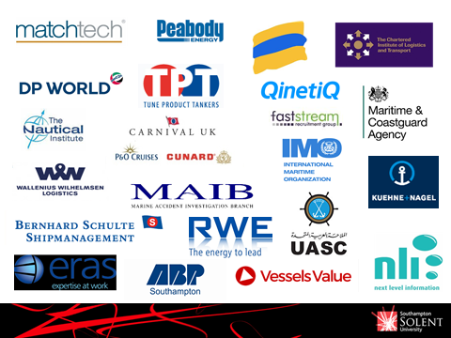
Degree curriculum
Working in close collaboration with the global maritime industry we have developed a dynamic and exciting curriculum.
We focus on real life learning which means your work and assessments prepare you for the tasks you will be doing when you start your job.

Slide 16
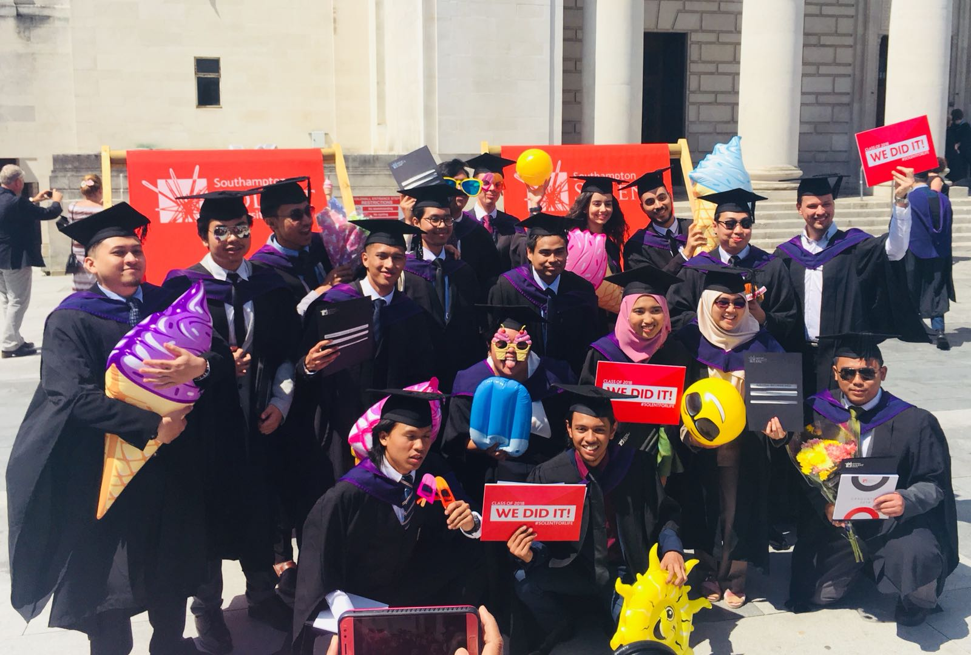
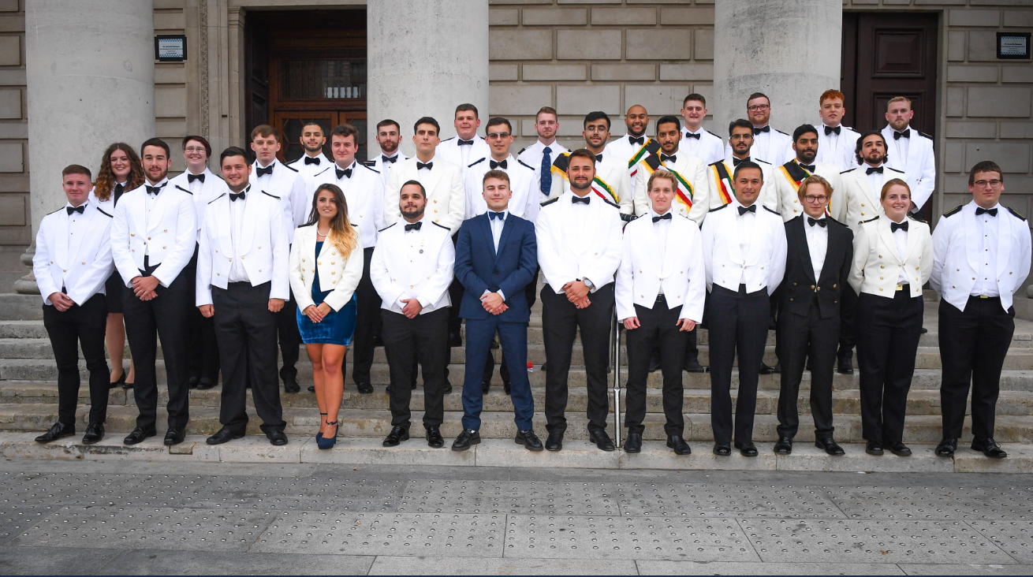
Joining Solent
MSc International Maritime Business
MSc International Shipping & Logistics
We are happy to discuss the content of our courses with you later or you can find them on our website

Slide 17
Taught Course content
MSc International Maritime Business
MSc International Shipping & Logistics
Maritime Management
International Maritime Law
Maritime Operations and Transport
Economics of International Trade and Shipping
Research Methods and Proposal
Dissertation (degree specific)
International Trade and Commercial Law
Finance and Business Risk
Maritime Management
International Maritime Law
Maritime Operations and Transport
Economics of International Trade and Shipping
Research Methods and Proposal
Dissertation (degree specific)
Supply Chain Management
Operational Risk Management

Slide 18
Our degrees are accredited by industry bodies: Chartered Institute of Transport & logistics Chartered Institute of SHIPBROKERS

Slide 19
INDUSTRY SPEAKERS,VISITS, CONFERENCES, NETWORKING, SOCIAL LIFE
At Solent we believe that the things you do outside the classroom are just as important to your overall education and development.
Solent has a proud history of student clubs and societies and world-class sports facilities available to all our students.

Slide 20
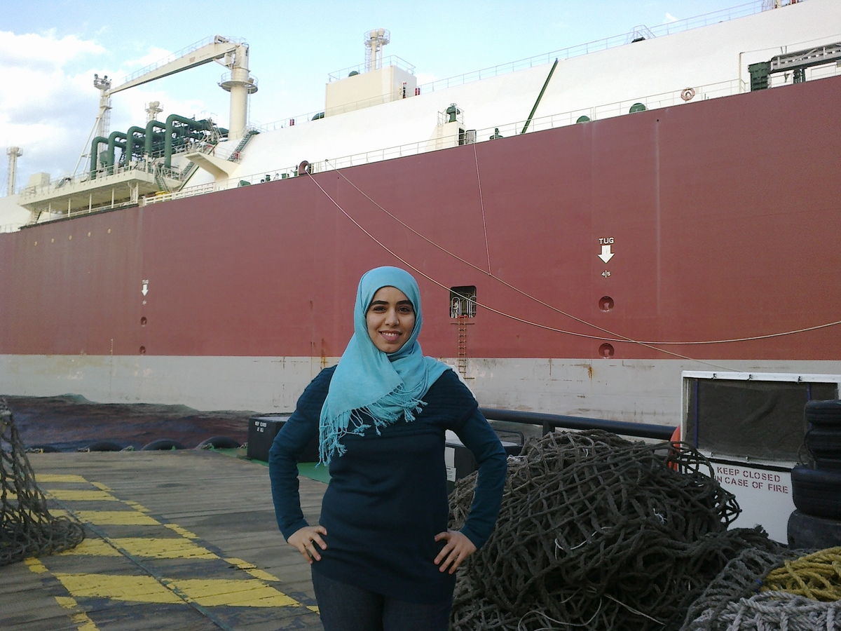
Field tripS
All our degree students, including Top-up and Masters students have opportunities to join visits in the UK and EU.
Previous visits have included:
IMO Headquarters in London
Port of Rotterdam
Port of Antwerp
The Baltic Exchange
Lloyd's of London
Bank of England
Southampton Port and Container Terminal
DP World London Gateway
Metal Exchange
Freight Liner Terminal, Oil Spill Response Limited

Slide 21
We’re Truly global
We are proud to have graduates from across the globe including:
Angola, Bahamas, Belgium, Brazil, Bulgaria, Burma, China, Colombia, Cyprus, Denmark, Estonia, Finland, France, Georgia, Germany, Ghana, Greece, Honduras, Hong Kong, Italy, India, Indonesia, Iraq, Latvia, Lithuania, Kenya, Malaysia, Montenegro, Netherlands, Nigeria, Norway, Panama, Philippines, Poland, Romania, Qatar, Saudi Arabia, Senegal, Singapore, Sri Lanka, Somalia, Sweden, Syria, Trinidad, Turkey, Ukraine, UAE, USA, Venezuela, Vietnam and Zimbabwe

Slide 22
AND WE CARE! – OUR Student SUPPORT
STUDENT HUB
The one stop shop!
General student support
Financial advice
Academic affairs
Health & Wellbeing
Disability support
STUDY & ACADEMIC SUPPORT
Develop your study skills!
Writing reports & essays
Critical analysis
Referencing
Research skills
INTERNATIONAL STUDENT SUPPORT TEAM
Life in the UK
Visas and employment
General advice
Questions for a recent graduate about international life at Solent? Contact an
International Alumni Ambassador

Slide 23
Be Part of a Community
STUDENT LED SOLENT MARITIME SOCIETY

Slide 24
1 year at Solent
Tuition Fees
Living Expenses
Expenditure | Average cost per week | Average cost per academic year*
Solent University student residence (2021-22 figs) (incl. utility bills: heating, electricity, water) | £108.50 - £154 | £4464 - £6336 (over 41 weeks)
Food | £30 - £40 | £1,200 - £1,600
Toiletries, laundry, etc | £12 | £480
Books and other material | £10 | £400
Leisure/social (entertainment, going out) | £30 | £1,200
Mobile phone | £10 | £400
Internet | £6 | £240
Contents insurance | £2 - £3 | £80 - £120
TV Licence | £3.98 | £159
2022/23 Full-time Study
Bachelor: £14,250
MA: £14,100
MSc: £14,550
Solent ranked 7th most affordable British University for international students

Slide 25
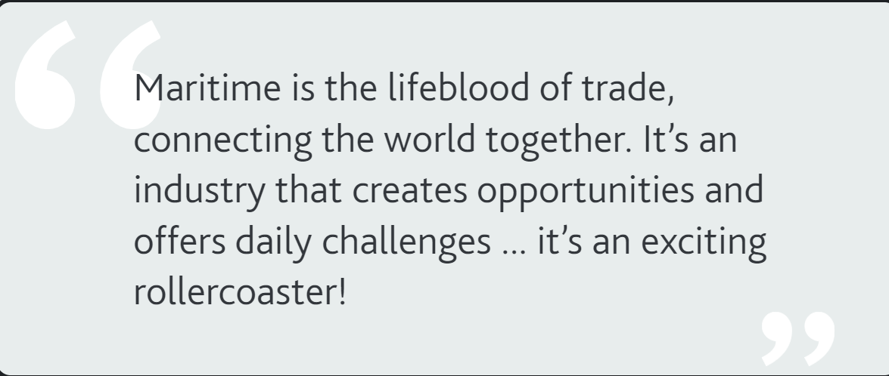
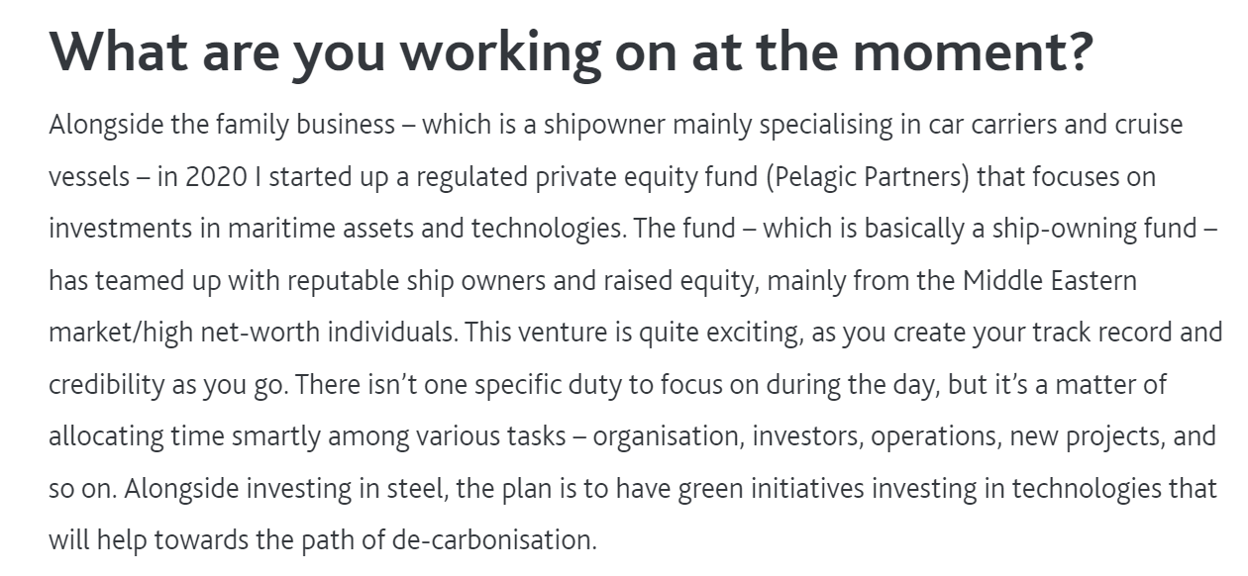
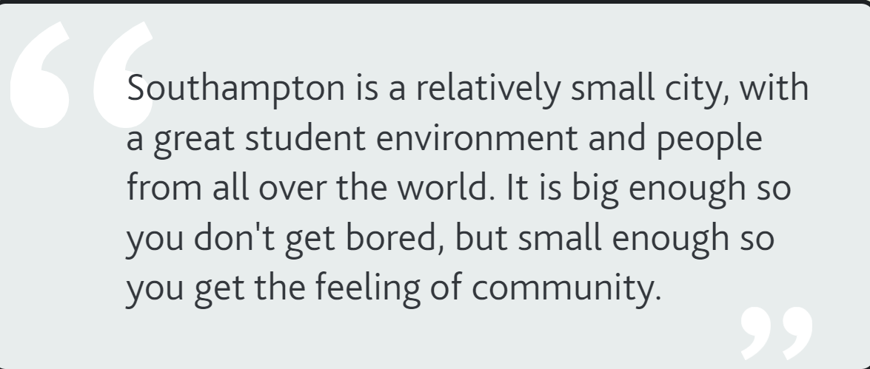
Hear from our Students:
Notes:
Students with the American High school diploma min. GPA 3.0 can go in a foundation year. For year 1 entry, students will also need APs, SATs or IB certificates
2.8 GPA + 32 UCAS points from minimum of 3 IB Certificates at HL
GPA 2.8 + AP with minimum grade 3 in 2 relevant subjects

Slide 26
Value Added Service from Sea and Beyond
Visa Assistance
Immigration to UK, Australia, Canada and EU
Dependent visa for family
Stay Abroad
Get the most economical flat near to the college
Share the expenses by clubbing with other students
Financial Assistance
No DSA, Direct deals with Banks and NBFCs
Best Interest rate in the market
Forex Remittance
CV/SOP preparation
Hassle free process
1-2% Savings
Of the transactional amount
Prepare custom made CV for immigration purpose
Build statement of purpose using proven methods

Slide 27
THANK YOU VERY MUCH FOR YOUR TIME. DO YOU HAVE ANY QUESTION(S)?

